Slide 1
If I Were King…
Sermon on Sunday, November 22, 2015
Based on Daniel 7:13-14

Slide 2


Slide 3
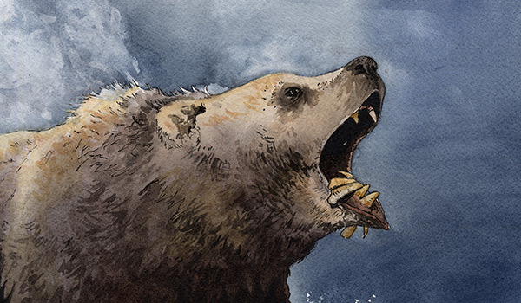

Slide 4
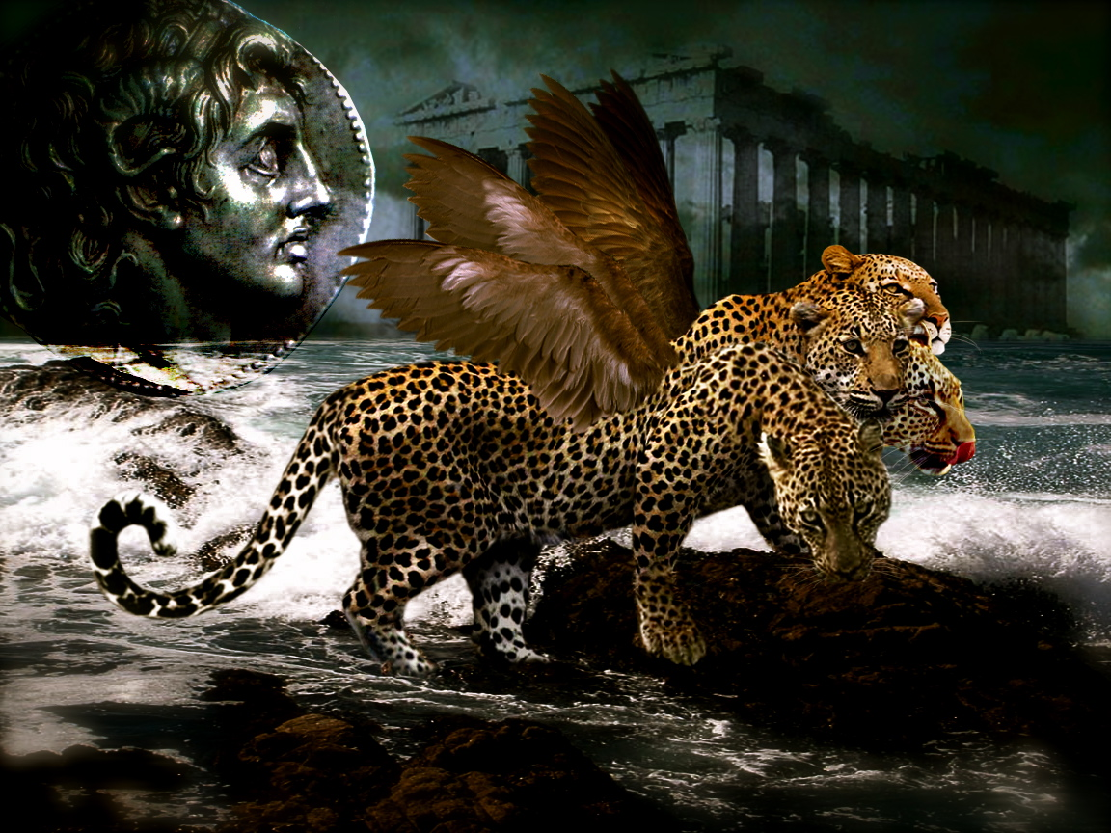

Slide 5
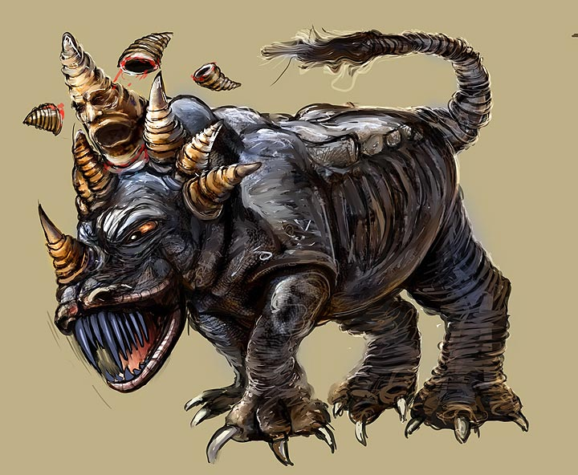

Slide 6
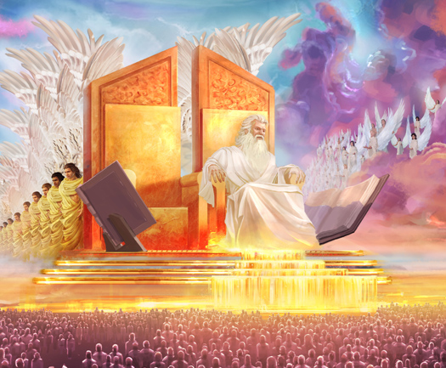

Slide 7
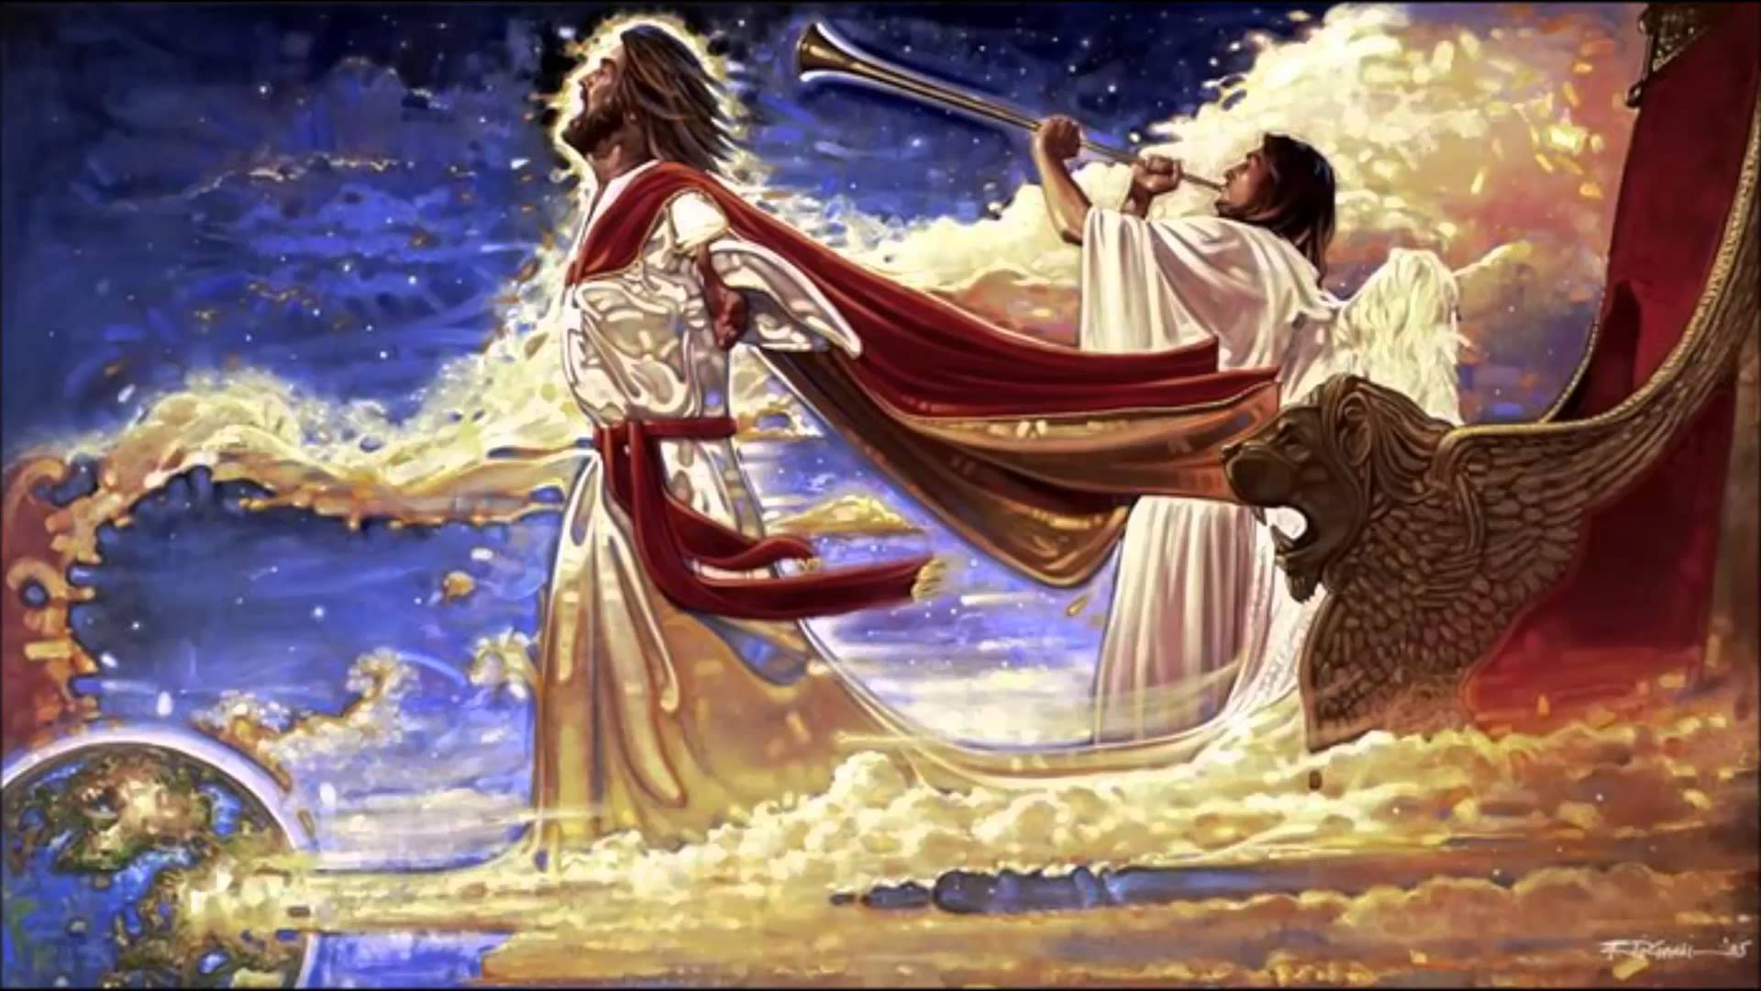

Slide 8
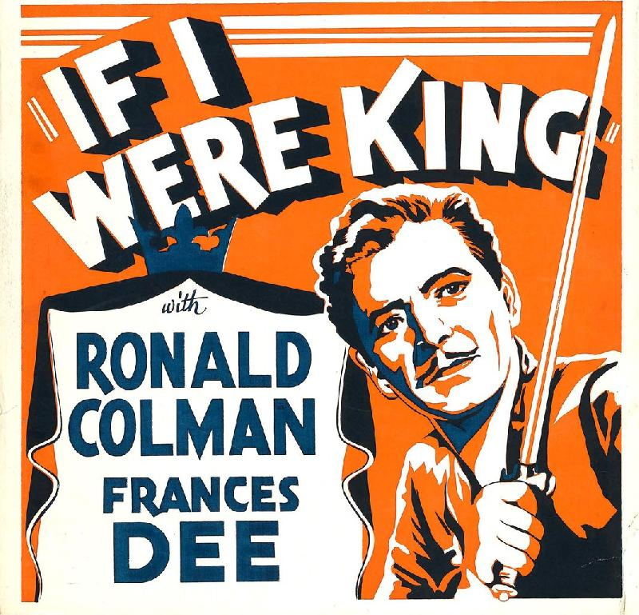

Slide 9


Slide 10


